Slide 1
THIS IS A PROJECT ON THE DATABASE SYSTEM AND RECORDS OF STUDENTS WHO PARTICPATE IN EXTRACURRICULAR ACTIVITIES IN SCHOOL

Slide 2
INTRODUCTION
NAME:LINDA TETTEH
COURSE TITTLE:DATABASE TECHNOLOGY/DATA MANGEMENT
COURSE TIME:10AM-12PM FIRST SERMESTER
COLLEGE:INTERCOM PROGRAMMING AND MANUFACTURING COMPANY
PROJECT TITTLE:RECORDS OF EXTRACURICULAR ACTVITIES IN A SCHOOL
INSTRUCTOR NAME:RICHARD ADU

Slide 3
TABLE OF CONTENT
BREIF DESCRIPTION OF PROJECT
PROBLEM DEFINITION
SOLUTION
WHAT IS DATA MANAGEMENT
WHAT IS ORACLE SQL
TYPES OF SQL COMMANDS AND DEFINITIONS
DATA MODELER DIAGRAM(LOGICAL AND RELATIONAL DIAGRAM)
CONTENT IN TABLE OF USER
SAMPLE PICTURES OF STUDENTS
CONCLUSION

Slide 4
BREIF DESCRIPTION OF PROJECT
This project is about collecting and keeping of data of student in a school who participate in extracurricular activities in school. This is document and keep records of such student in a database system.

Slide 5
PROBLEM DEFINITION
There hasn’t been any records or information on students who participate in extracurricular activities and document.
Student are not able to identify their career path after leaving the first cycle institution.

Slide 6
WHAT IS DATA MANAGEMENT
Data are facts and statistics collected together for reference and analysis. Database Management Systems (DBMS) are software systems used to store, retrieve, and run queries on data.
Oracle SQL is a Structured Query Language(SQL) developed by Dr E.F Codd in 1970.SQL is used to access and manipulate a value within the database.
There are four main Languages in SQL
DDL stands for DATA DEFINITION LANGUAGE
DML stands for DATA MANIPULATION LANGUAGE
DCL stands for DATA CONTROL LANGUAGE
TCL stands for TRANSACTION CONTROL LANGUAGE

Slide 7
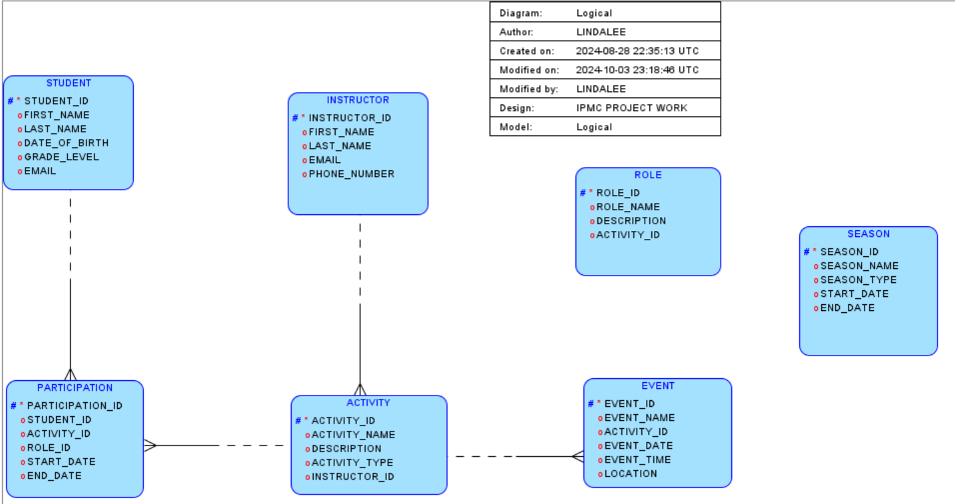
LOGICAL DIAGRAM

Slide 8
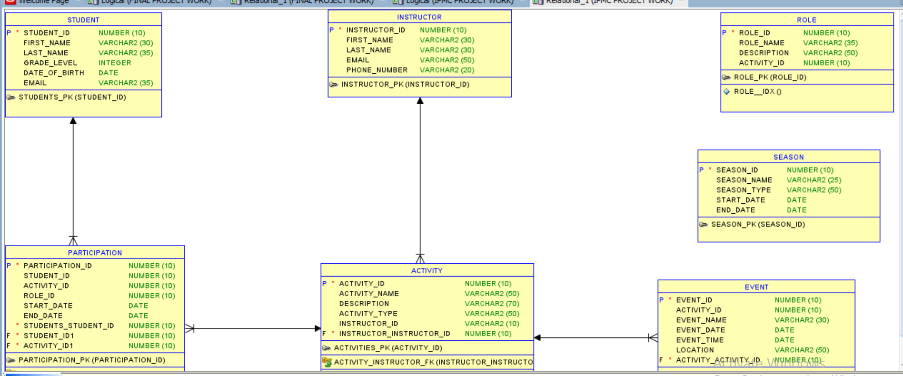
RELATIONAL DIAGRAM

Slide 9
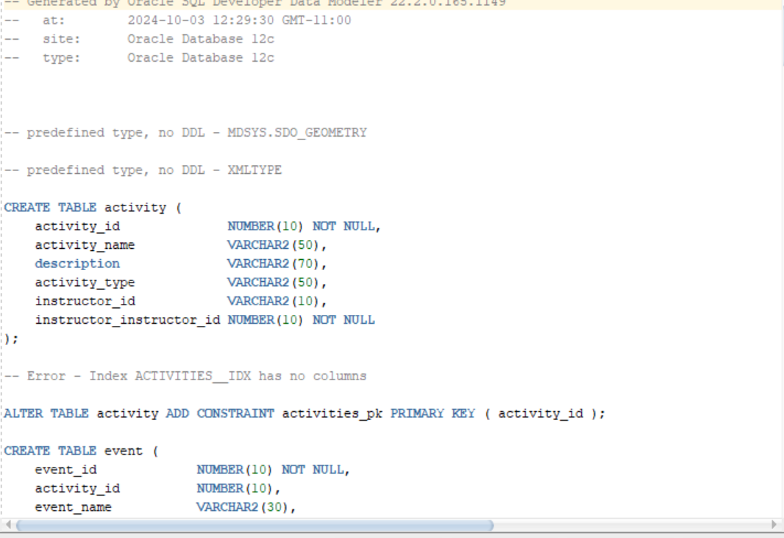
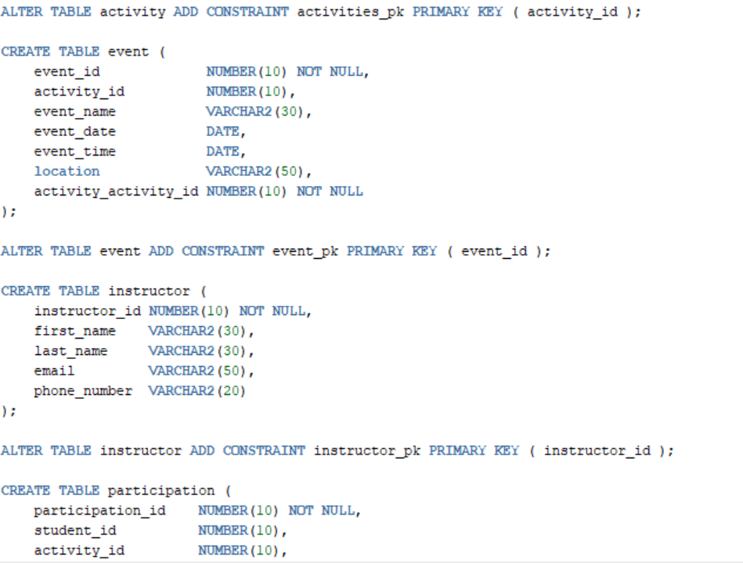
THE DATA DEFINITION LANGUAGE(DDL)

Slide 10
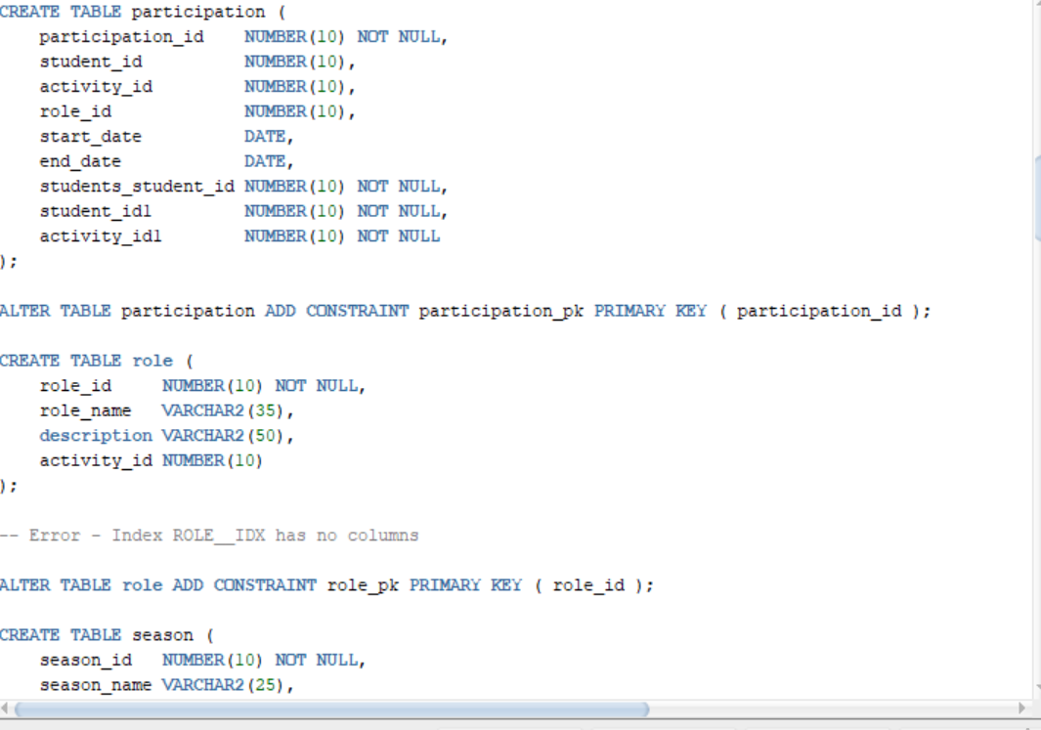
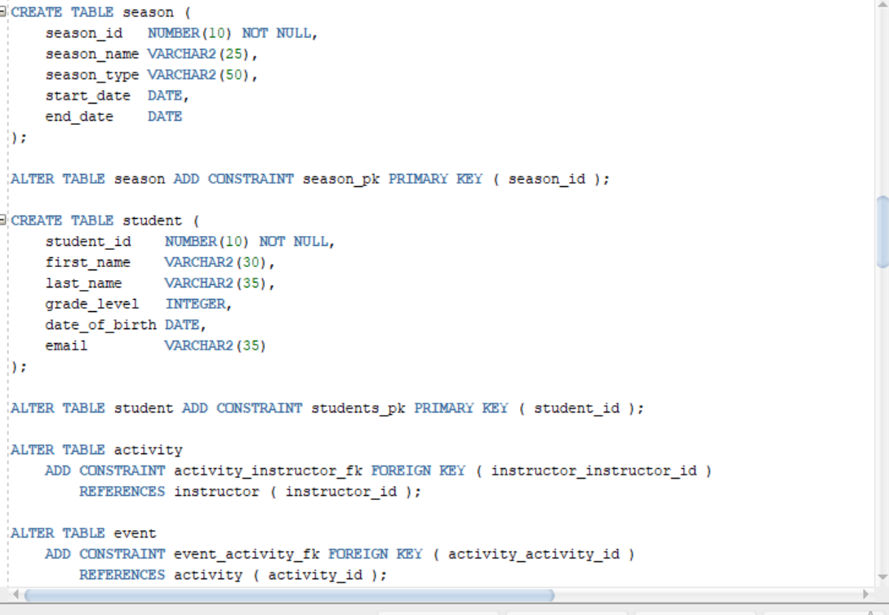
DATA DEFINITION LANAGUAGE(DDL)CONT

Slide 11
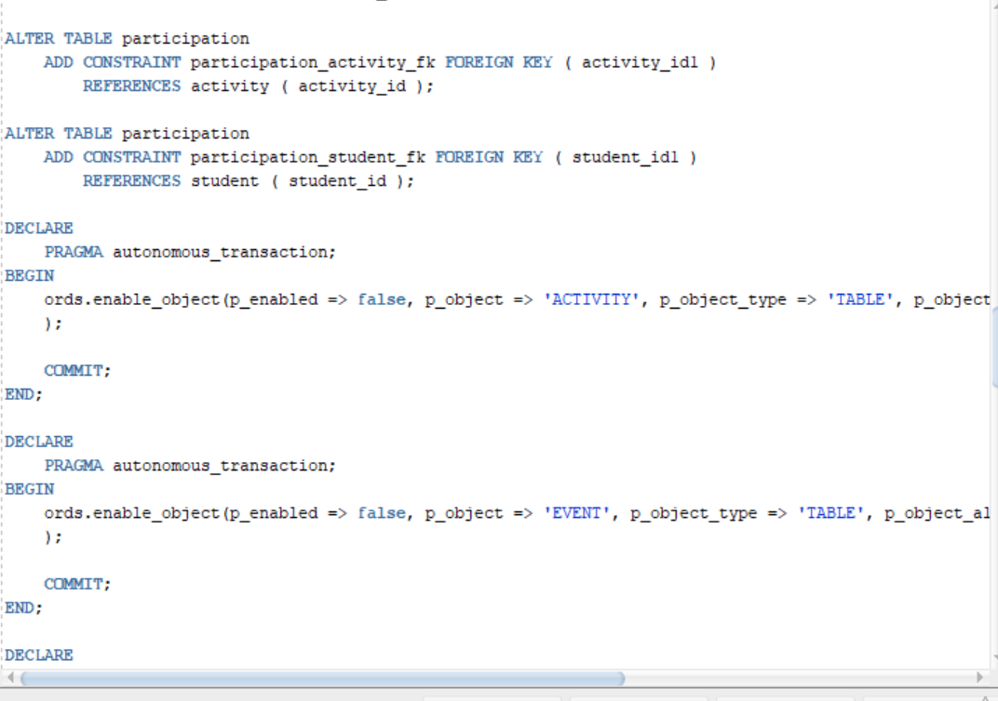

Slide 12
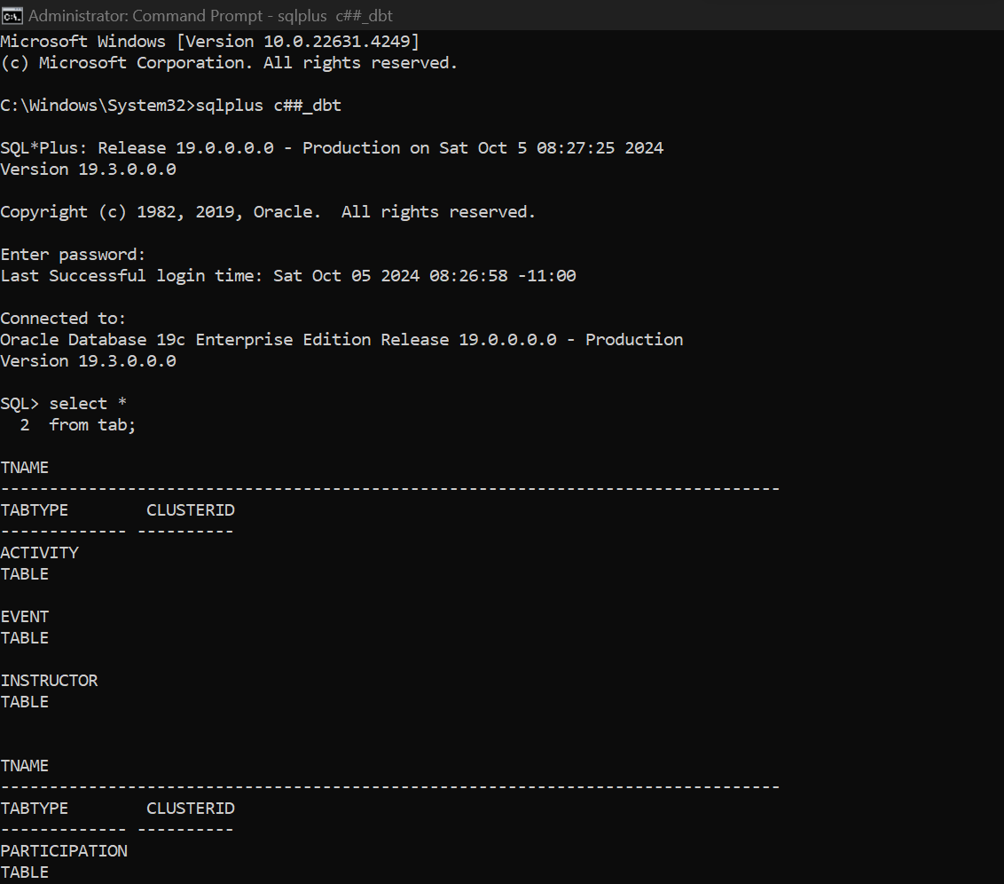
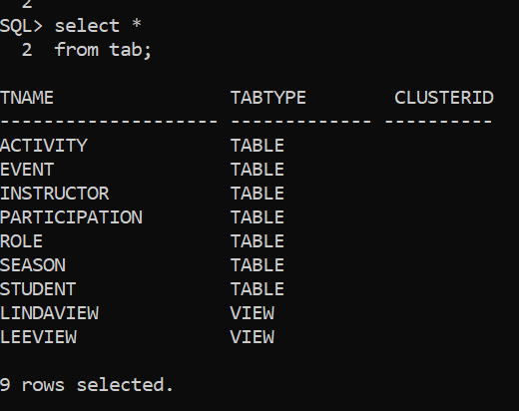
CONNECTING TO MY USER TO DISPLAY TABLES

Slide 13
DISPLAY OF COLUMNS AND ROWS IN A TABLE

Slide 14
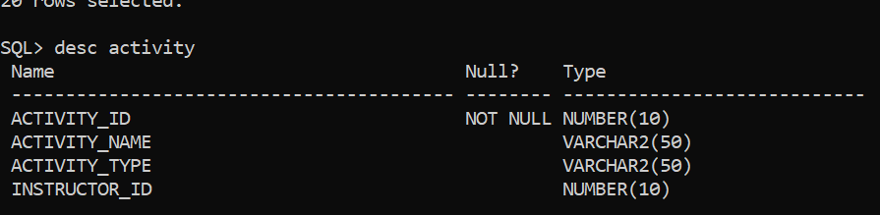
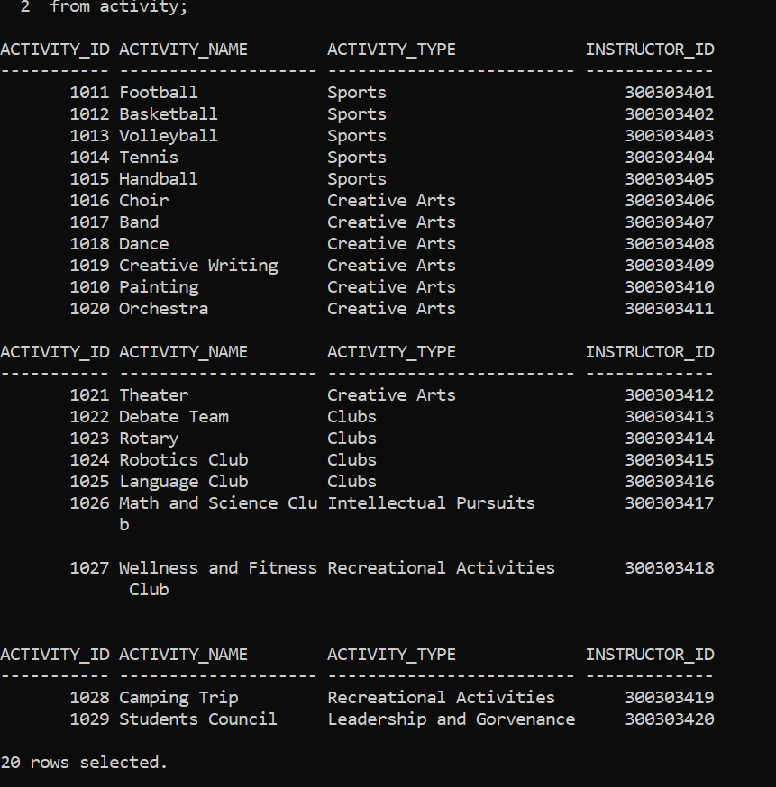
THE ACTIVITY TABLE
This are the Columns in the activity table
These are the Rows in the Activity Table

Slide 15
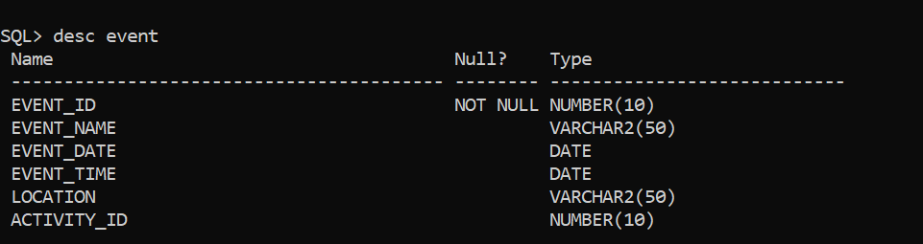
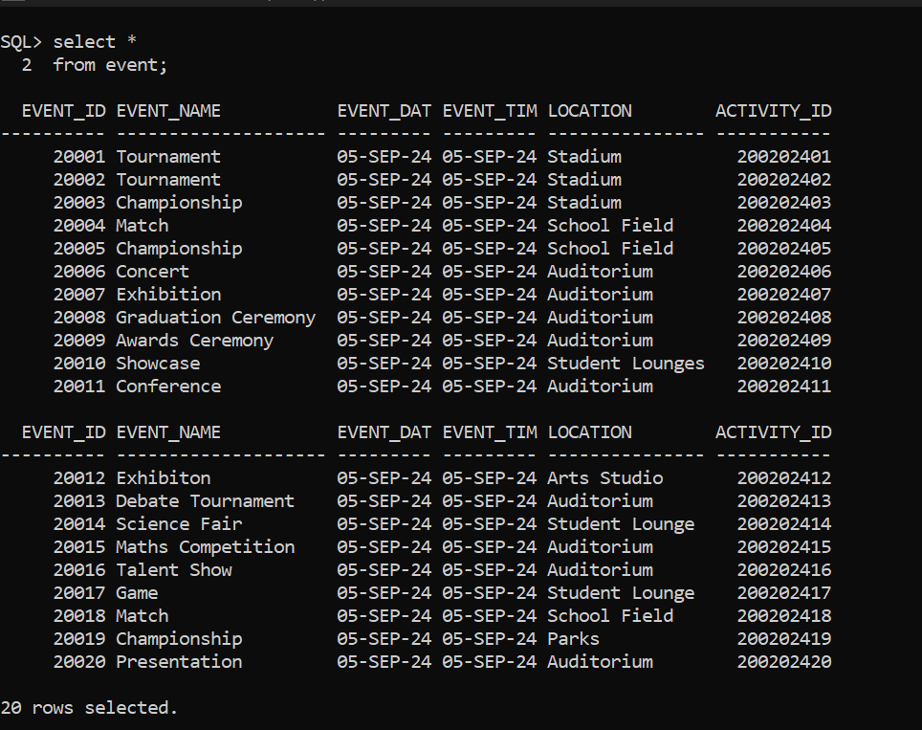
THE EVENT TABLE
This is the Columns in the Event Table
This is the Rows in the Event Table

Slide 16
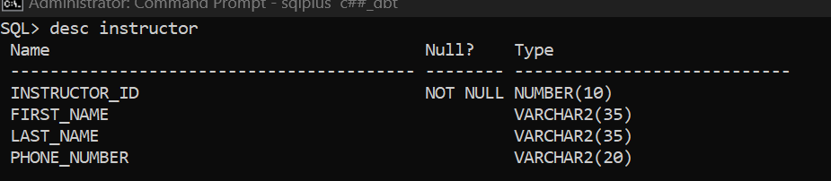
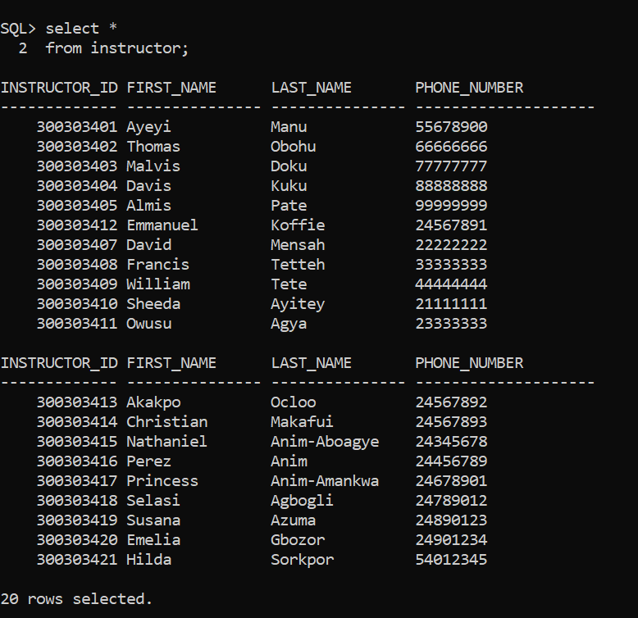
THE INSTRUCTOR TABLE
This is the Column in the Instructor Table
This is the Rows in the Instructor Table

Slide 17
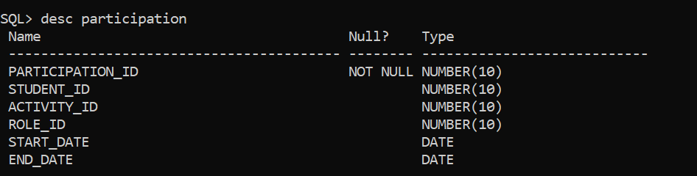
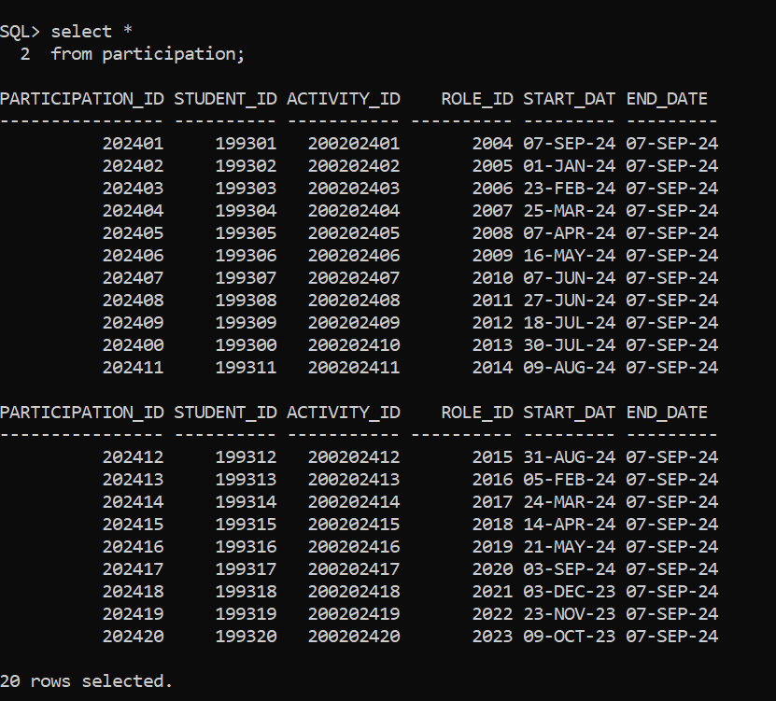
THE PARTICIPATION TABLE
This displays the Columns in the Participation Table
This displays the Rows in the Participation Table

Slide 18
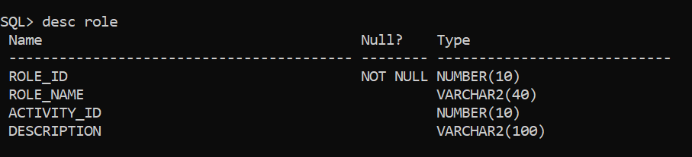
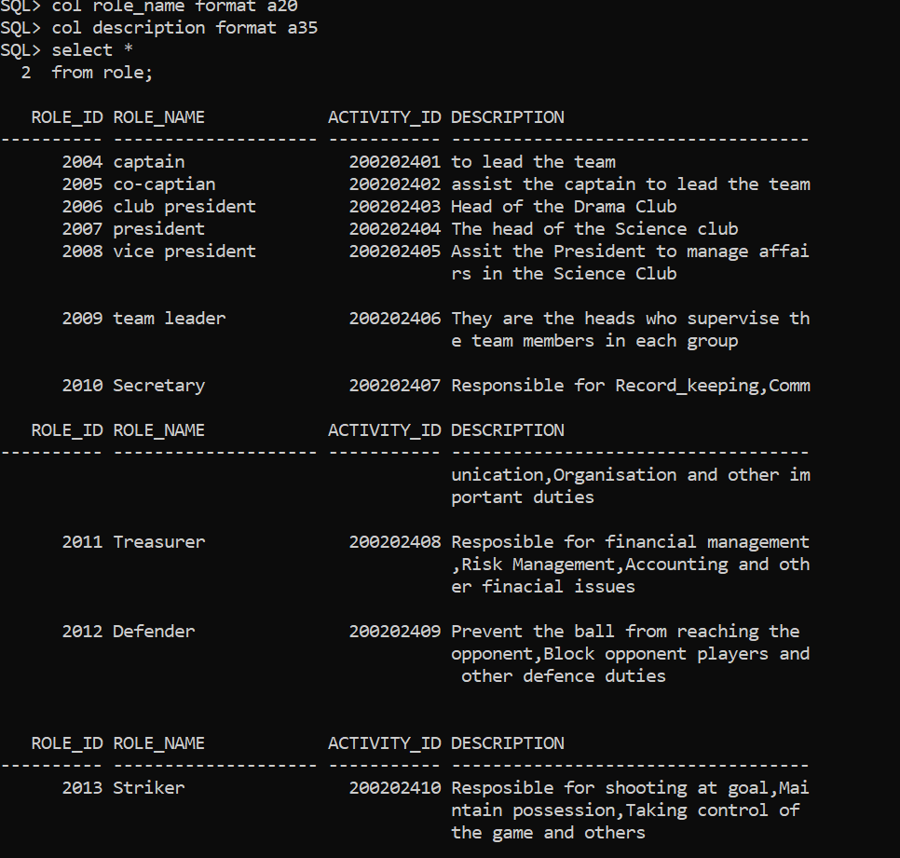
THE ROLE TABLE
This is the display of the Columns in the Role Table
This is the display of Rows in the Role Table

Slide 19
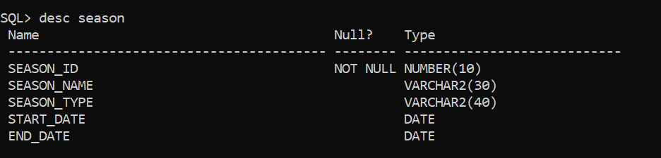
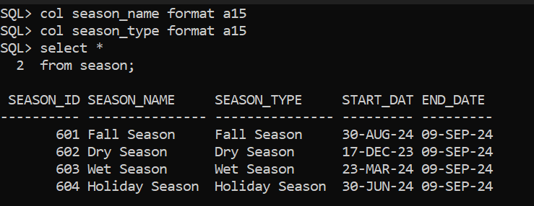
THE SEASON TABLE
This is the display of Columns in the Season Table
This is the display of Rows in the Season Table

Slide 20
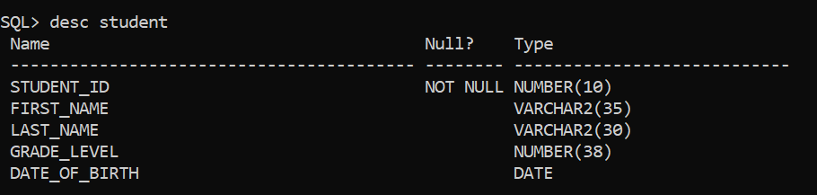
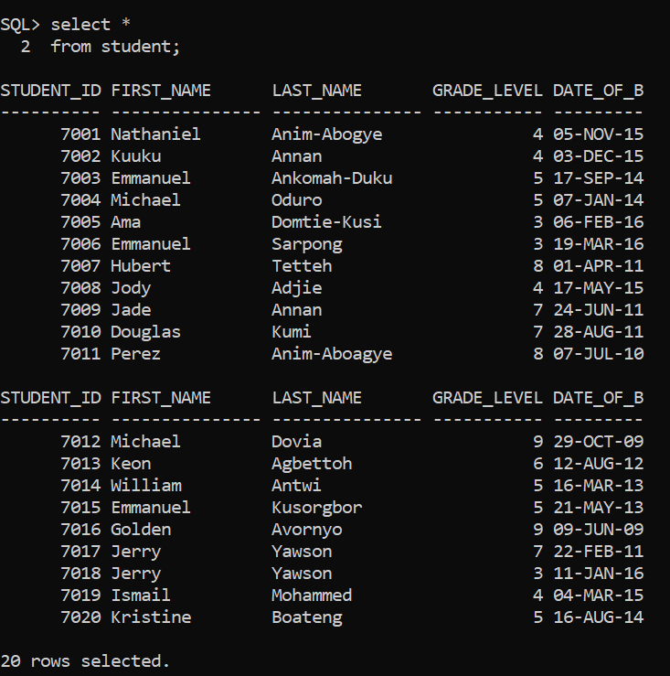
THE STUDENT TABLE
This is the display of Columns in the Student Table
This is the display of Rows in the Student Table

Slide 21
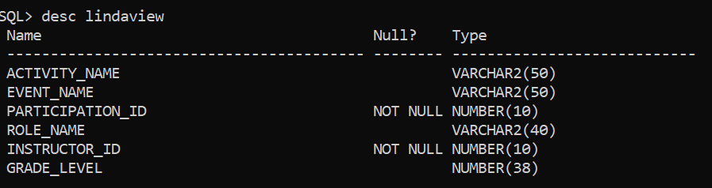
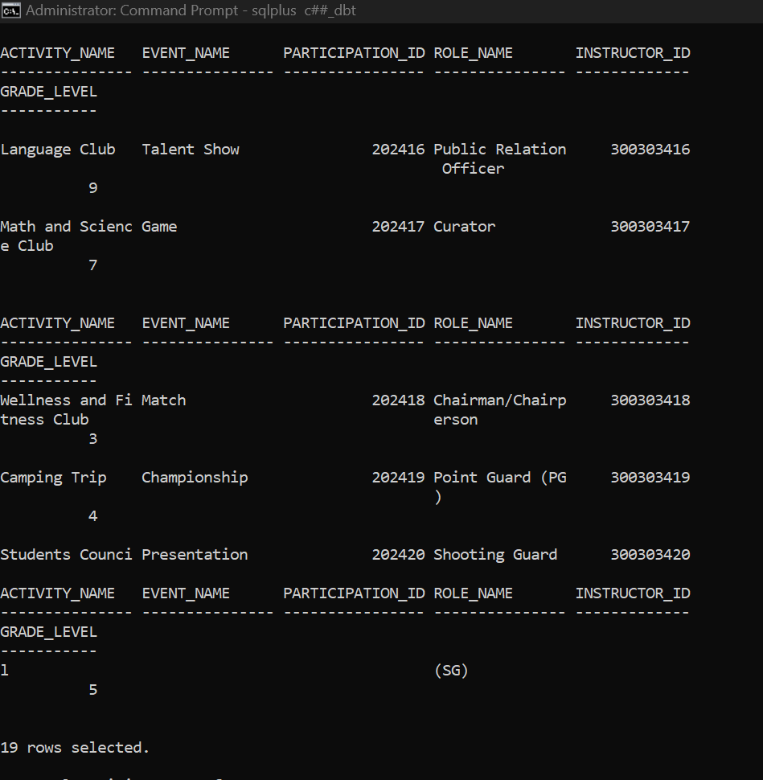
VIEW FROM THE USER
This is the Rows in the View
This is the Columns in the View

Slide 22
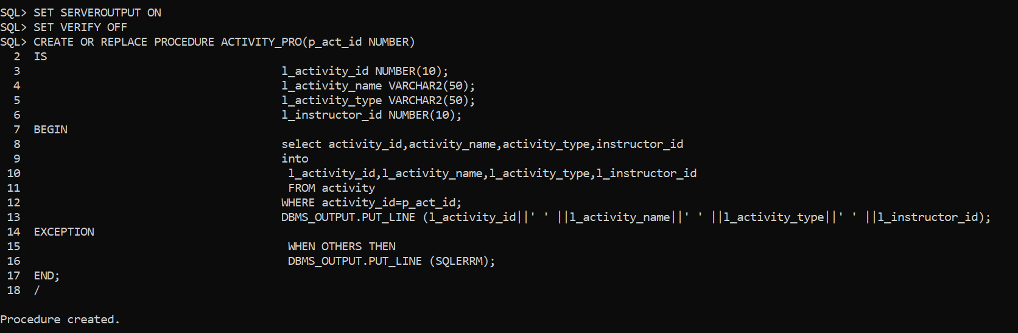
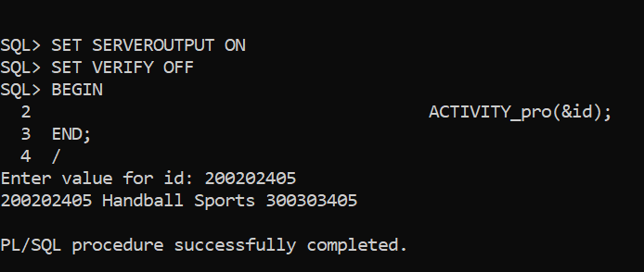
PROCEDURE CREATION

Slide 23
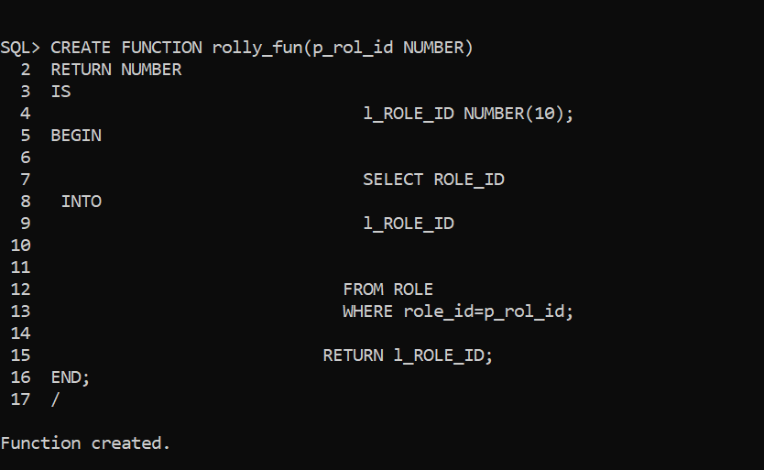
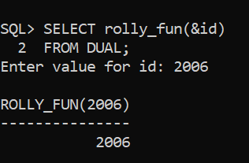
FUNCTION CREATION

Slide 24
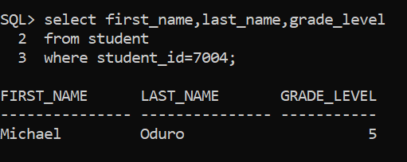
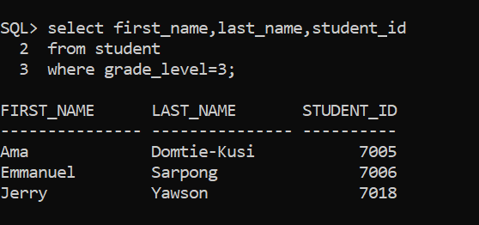
THIS IS QUERY DISPLAY OF THE NAME FROM THE STUDENT TABLE

Slide 25
SOLUTION
Schools must encourage and enforce Students to participate in extracurricular activities in order to identify their talents and hobbies. Therefore students will be able find their career path after school.

Slide 26
CONCLUSION/SUMMARY
This project is done to know the benefit of schools establishing extracurricular activities in school and how it will help them find their paths in life. Participation of student in extracurricular activities will help students and their guardians to know the strength and weakness of their children.

